Slide 1



React Data Fetching Patterns
20
From SPAs to SSG to SSR to RSCs
Kevin Van Cott
Senior Software Engineer / OSS Maintainer

Slide 2


Who Am I?
Senior Software Engineer / OSS Maintainer
I currently work at RentVision in Lincoln, NE
Other companies I’ve worked for: Manifest Cyber, Fusion Medical Staffing, ALLO Fiber, Talent Plus, Nebraska DHHS
Open Source Contributor – TanStack Table, MRT
TanStack Consultant - Dedicated Support | TanStack
Runner, Hiker, Traveler

Slide 3

What We Will Learn in this Talk?
A very brief history of React
What kind of apps/websites can be built with React
The most popular ways to build with React (Vite, Next.js, Remix)
Dig into some code!
The pros and cons of these different React Frameworks

Slide 4
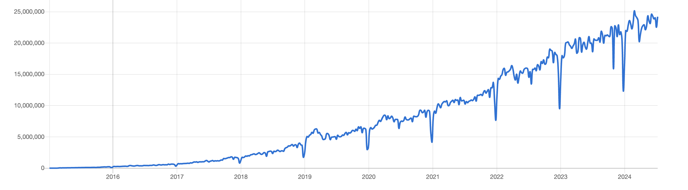
A Brief History of React
Initially released in 2013 by Facebook
Became stable in 2015 (v15)
Hooks released in 2019 (v16.8)
Concurrent Rendering features released in 2022 (v18)
React 19 – releasing sometime during 2024

Slide 5


What Can We Even Build With React?
“React is a Client-Side JS Library, Right?”
Websites
Web Applications
Mobile Apps (React Native)
React itself is just a client-side JavaScript Library that only runs in the browser
But Multiple “Meta Frameworks” have popped up over the years to make writing React a apps a full-stack experience

Slide 6

What’s the Difference Between a Website and a Web App?
Websites
Primary Purpose: Display content to users.
Content Discovery: Optimized for SEO to make content easily discoverable.
Functionality: Often limited to basic interactions such as navigation links and forms. (Limited State Management)
Performance: Prioritizes quick load times and static content delivery.
Data Handling: Mostly for displaying static content and receiving basic form submissions
Web Applications
Primary Purpose: Provide interactive and functional experiences
Content Discover: Often behind a Login/Authentication wall.
Functionality: Rich interactivity with complex client-side logic. (Can have heavy State Management)
Performance: Focuses on efficient client-side performance and dynamic content updates.
Data Handling: Often involves CRUD operations, API integrations, and real-time data updates.

Slide 7
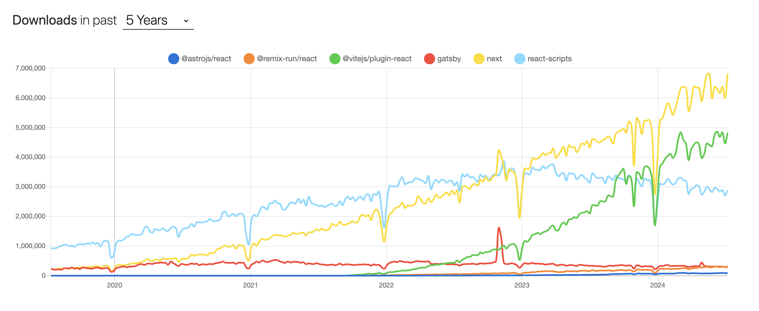
React Frameworks over the years
@astrojs/react vs @remix-run/react vs @vitejs/plugin-react vs gatsby vs next vs react-scripts | npm trends

Slide 8

It’s All About Data
What’s the Difference Between all These Frameworks?
Each framework has different opinions and implementations for both loading data into your website/application and for submitting data

Slide 9

Chapter 1: Client-Side SPAs
What is a SPA? – Single Page Application
In a traditional SPA, the React project is only part of the view layer.
All data fetching is initiated client-side
 | Runs on Server | Runs on Client
Client-Side SPA | ❌ | ✅
1. User hits the website
Browser
Server
2. Server responds with static HTML, CSS, and JavaScript Assets
3. Browser downloads JavaScript, then creates the React App. After React components start running, App data can start fetching

Slide 10

MVC
Model: Manages data and business logic.
Responsible for data retrieval, storage, and manipulation.
View: Represents the UI of the application.
Displays data from the Model to the user and sends user input to the Controller.
Controller: Acts as an intermediary between Model and View. Handles user input, manipulates the Model, and updates the View accordingly.
React usually goes here
React Meta Frameworks encompass can all MVC

Slide 11

Client-Side SPA examples
componentDidMount
useEffect
React Query (3rd party)

Slide 12

TanStack (React) Query
Why You Want React Query | TkDodo's blog
We’ll take a look at how one of the most popular 3rd party React Libraries can both simplify so much of our code and create better user experiences
TanStack Query Docs
Automatic Loading and Reloading states provided
Automatic Error Handling states
Adds a caching layer to reduce the total number of fetches
Prefetching
Polling and Re-fetching features
Pagination and infinite scrolling features
Better memoization re-rendering performance
Alternatives such as RTK Query, SWC, or Apollo are also good

Slide 13

Chapter 2: SSG and SSR (Back to the Server)
What is SSG? – Static-Site-Generation
What is SSR? – Server-Side-Rendering
Data can be fetched either at build time in a CI/CD pipeline, or run time on the server, or still client-side
The React Codebase can encompass the entire MVC model (optionally)
 | Fetches at Build Time | Fetches on Server | Fetches on Client
Client-Side SPA | ❌ | ❌ | ✅
SSG | ✅ | 🤔 | ✅
SSR | ❌ | ✅ | ✅
1. User hits the website
Browser
Server
2. Server responds with static HTML, CSS, and JavaScript Assets
BUT THE DATA IS ALREADY INCLUDED IN THE HTML!
3. (The client still fetch/refresh if it wants to)

Slide 14
Server-Side Fetching Examples
Next.js SSG (Static Site Generation
Next.js SSR (Server-Side Rendering)
Remix SSR (Server-Side Rendering)

Slide 15

Chapter 3: RSCs (React Server Components)
What are RSCs? – React Server Components
React Components that ONLY FETCH ON THE SERVER (And only run on the server in general)
Fetch on a per server component basis instead of being limited to fetching per page/route
Results in a reduced bundle size, because RSCs don’t run any* client-side JavaScript
New HTML can stream in (instead of JSON fetches)
Currently being pioneered by Next.js App Router
 | Fetches at Build Time | Fetches on Server | Fetches on Client
Client-Side SPA | ❌ | ❌ | ✅
SSG | ✅ | 🤔 | ✅
SSR | ❌ | ✅ | ✅
RSCs | 🤔 | ✅ | ❌*
1. User hits the website
Browser
Server
2. Server responds with static HTML, CSS, and JavaScript Assets
BUT THE DATA IS ALREADY INCLUDED IN THE HTML!
And Additional static HTML/CSS/JS content

Slide 16
React Server Components example

Slide 17

Conclusions
What types of Apps should be built as SPAs?
What types of Apps should be built with SSG?
What types of Apps should be built with SSR?
What types of Apps should be built with RSCs?

